Slide 1
Virtual Lab Classes
(using AR/VR/MR technology)

Slide 2
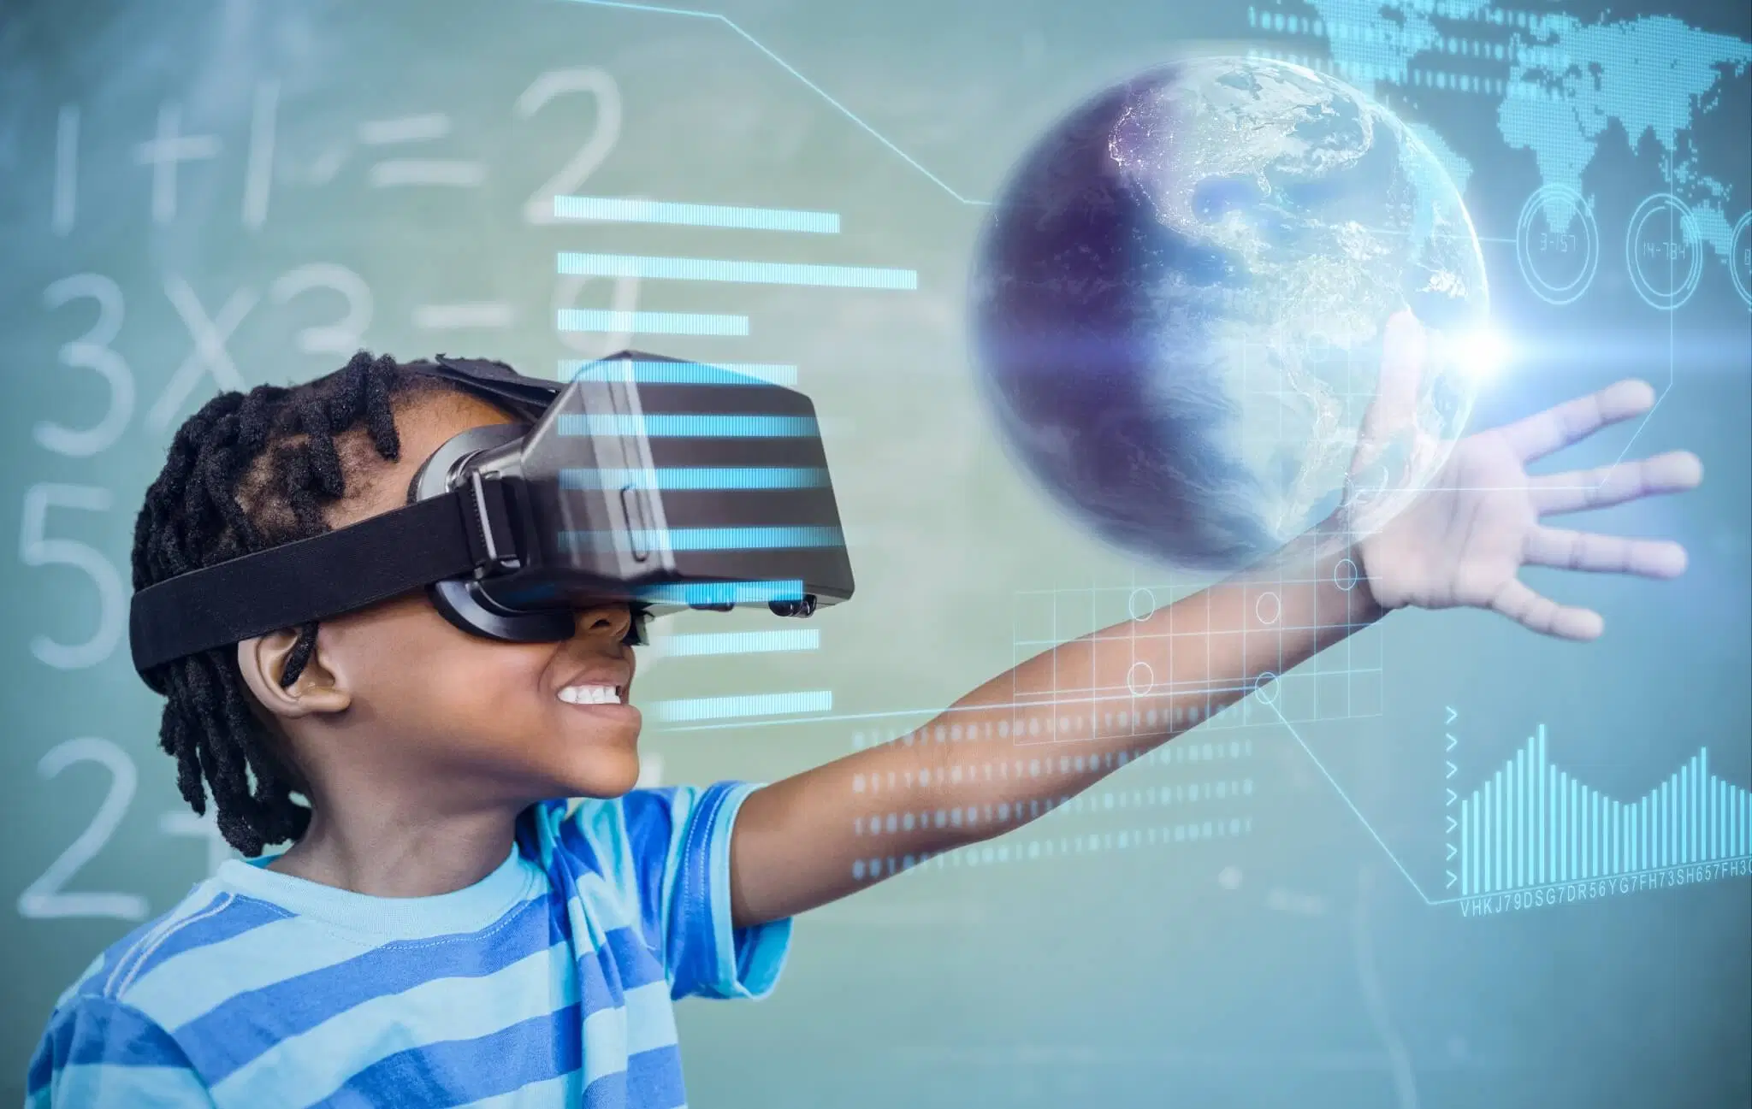
What is ….
Augmented reality (AR) adds digital elements to a live view often by using the camera on a smartphone.
Virtual reality (VR) implies a complete immersion experience that shuts out the physical world.
Mixed Reality (MR) experience, which combines elements of both AR and VR, real-world and digital objects interact.

Slide 3


COVID affecting Education
Student tend to become lethargic during online classes
Less interaction.

Slide 4
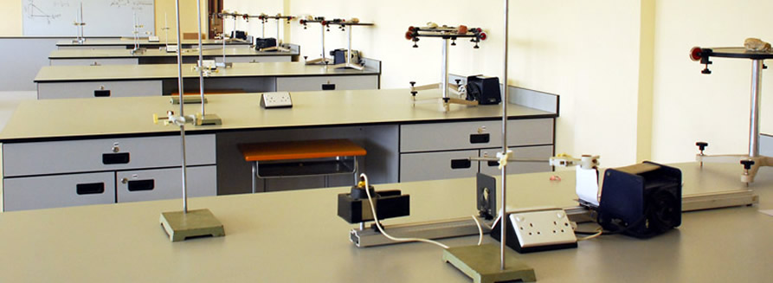
Covid affecting Practical Education
The essence of practical education is hampered.
Students are not able to grasp the actual concept through various online methods.
Hands-on experience is hindered.

Slide 5


Implementation
HOW
STEP 1 : We will take the photos of the Labs & classes to make a augmented reality OR you can say that we will Live detect OR Indirect view of the Physical real Class room & Labs.
STEP 2 : We will make a prototype of the 3D Model. To make that we will use 3D Modeling software(Autodesk Maya).
STEP 3 : Now the framework we will use is Unity software.
STEP 4 : Integrating the AR & VR with the Mobile App.
STEP 5 : There are wide variety of Head Mounted Display , but for better experience we will choose a VR as per the expense & budget.

Slide 6
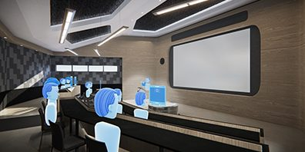
Where
Effortless involvement while sitting at home.
the advanced development of the VR devices has made VR an affordable and suitable interface for educations in different levels, including primary schools, secondary schools, colleges, and universities.
Availing subscription based service for novice researchers on heavy and non-affordable machineries.

Slide 7
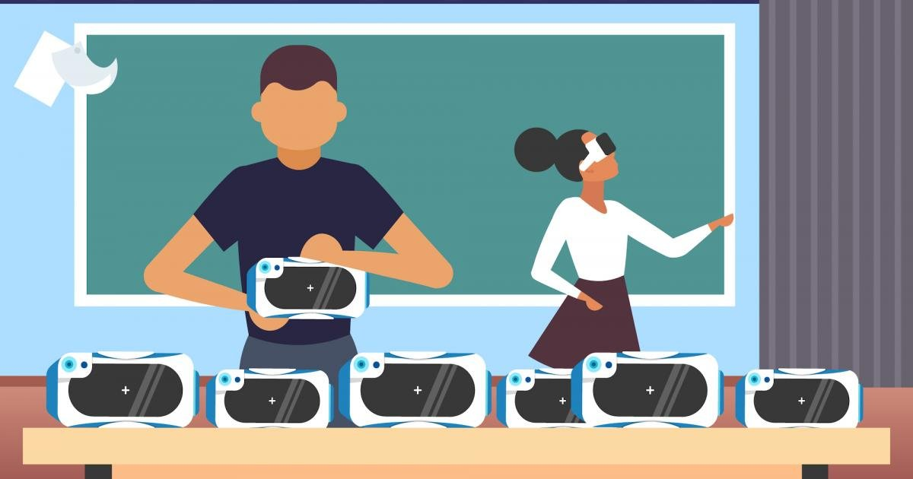
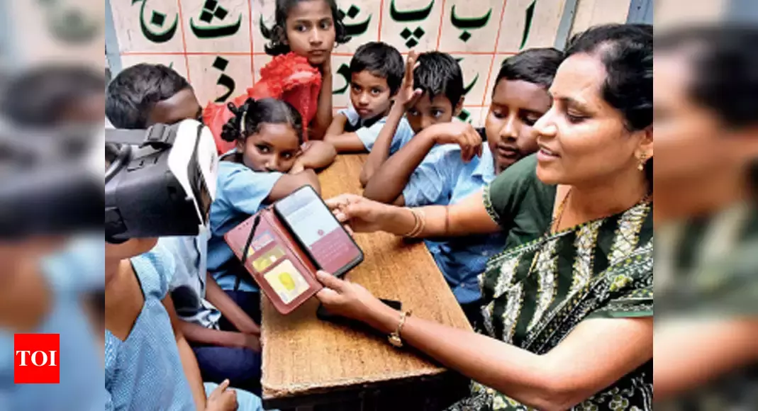
Cost efficient
Easy to implement in remote location.

Slide 8
Past implementation by some institution.

Slide 9
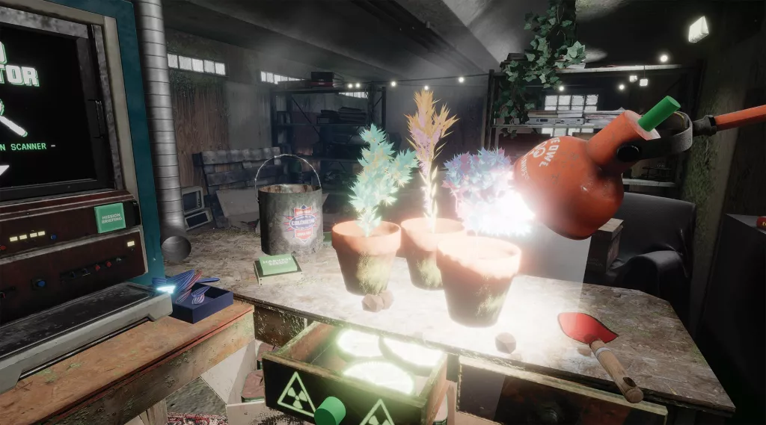
In 2007, Hougang Elementary school in Singapore applied an AR prototype in a typical primary (11 years-old) class to facilitate the learning of seed germination and plant growth

Slide 10


EdTech giant BYJU’s pavilion there is a game based augmented reality lesson.
Software giant TCS showcased a virtual chemistry lab. Wearing an Oculus headset you enter a virtual lab.

Slide 11
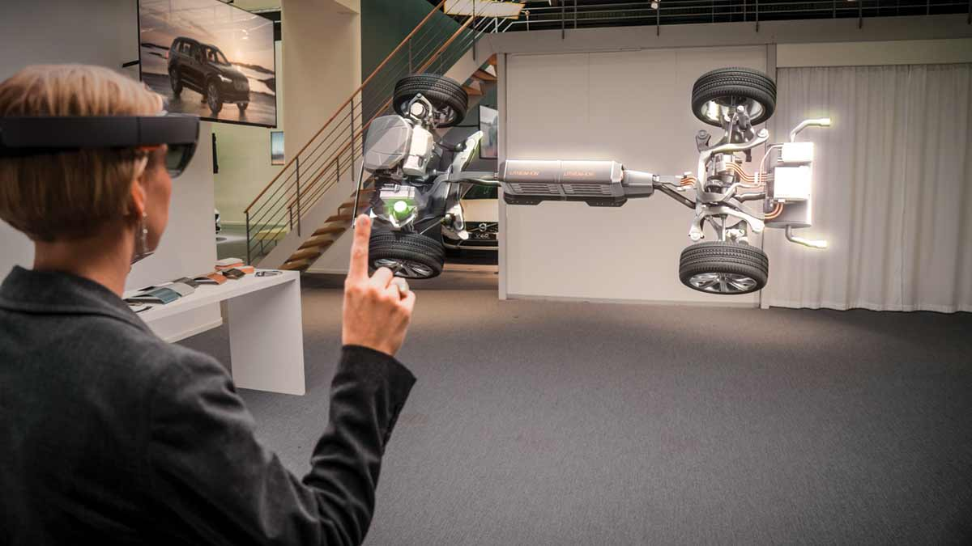
Benefits
3D models of components – and even the entire vehicle – long before physical parts are available.
Can make bodywork appear transparent to reveal the parts and systems underneath.
Vastly reduces the number of costly physical prototypes.

Slide 12
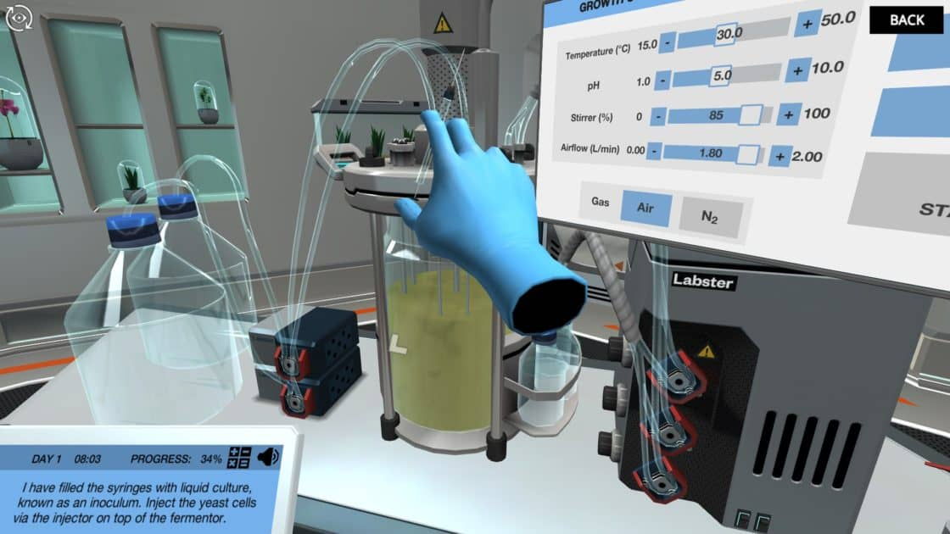
Contd..
Focus on one subject: VR headsets completely overwhelm students and force them to concentrate on one subject of studying 100%.
AR adds value to the courses because it recognizes when it is time to show contextual information related to the studying subject
AR and VR can be used to design a virtual classroom with students from all over the world.
Every outdoor sport with AR VR can be used to Train them better without damaging the body. Example Fencing , Boxing , Sport Which includes physical body practices.

Slide 13
THANK YOU

